Slide 1
Automated Weed Remover
For Row Crops
DHANUSH MS 4NM17EC040
ADITHYA ALEWOORAYA 4NM17EC006
SOURABH SHANBHOGUE 4NM17EC158 SATHWIK S PAWAR 4NM17EC191
Under the Guidance of
Mr. ANIL KUMAR BHAT
Assistant Professor Gd. II
Department of
Electronics & Communication Engineering

Slide 2
Contents
Introduction
Overview
Block Diagram
Requirement Analysis
Working and Implementation
Conclusion
References
Department of ECE
02

Slide 3
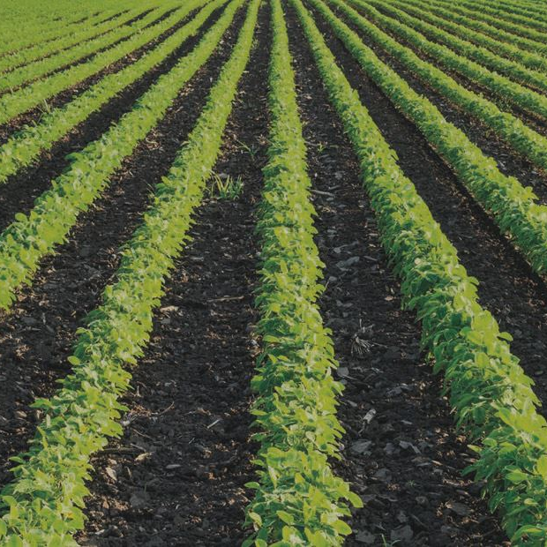
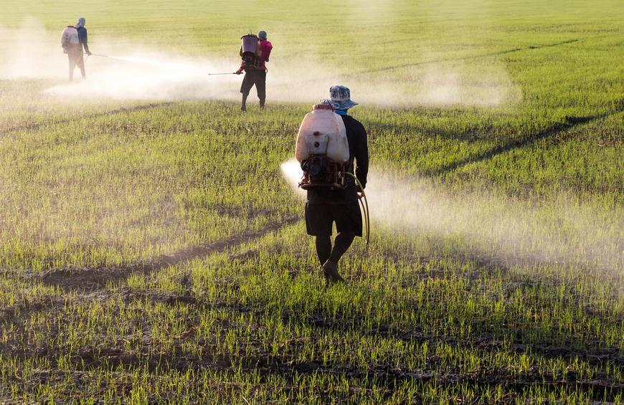
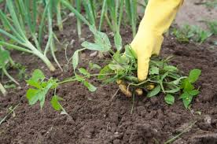
Introduction
Weeds in agriculture
Manual labor
Lots of herbicides
Automated system
Movement, detection
and treatment
Department of ECE
03

Slide 4
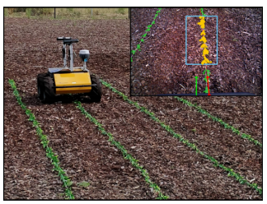
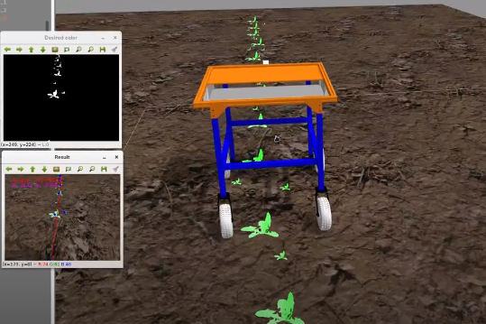
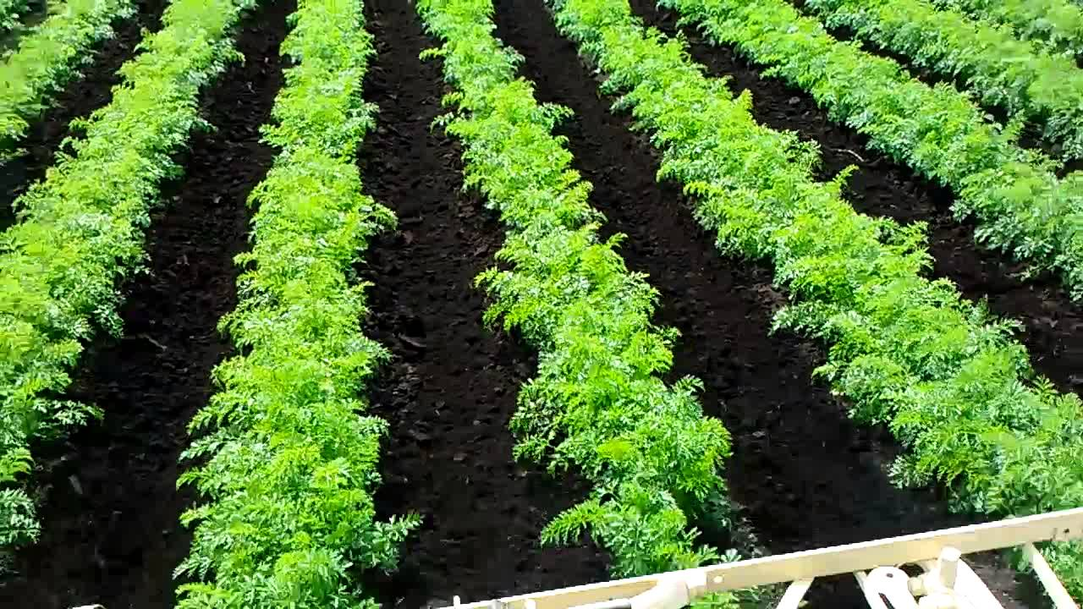
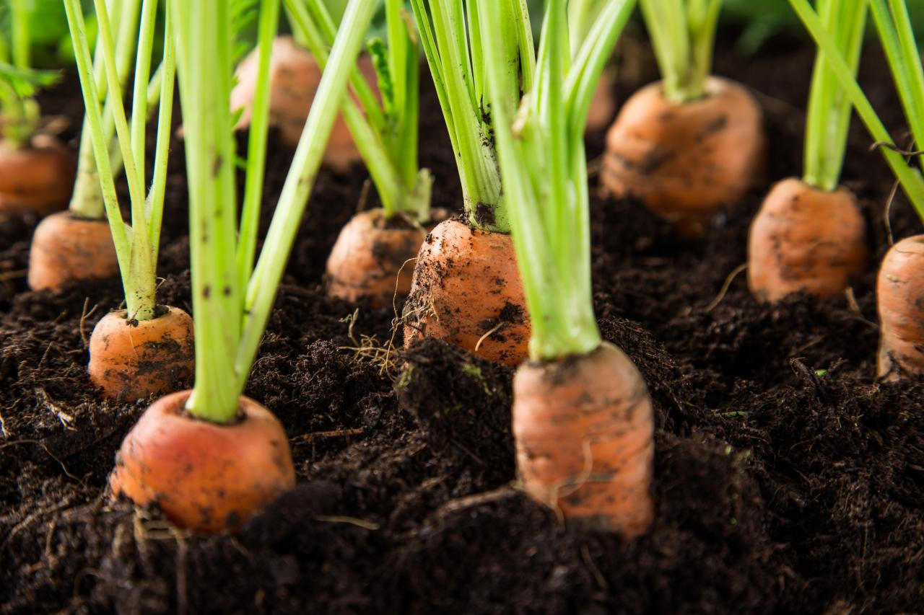
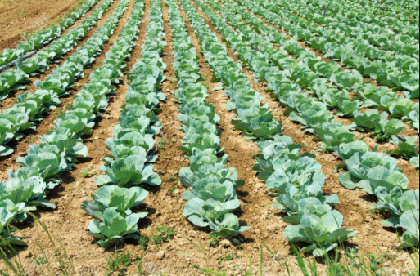
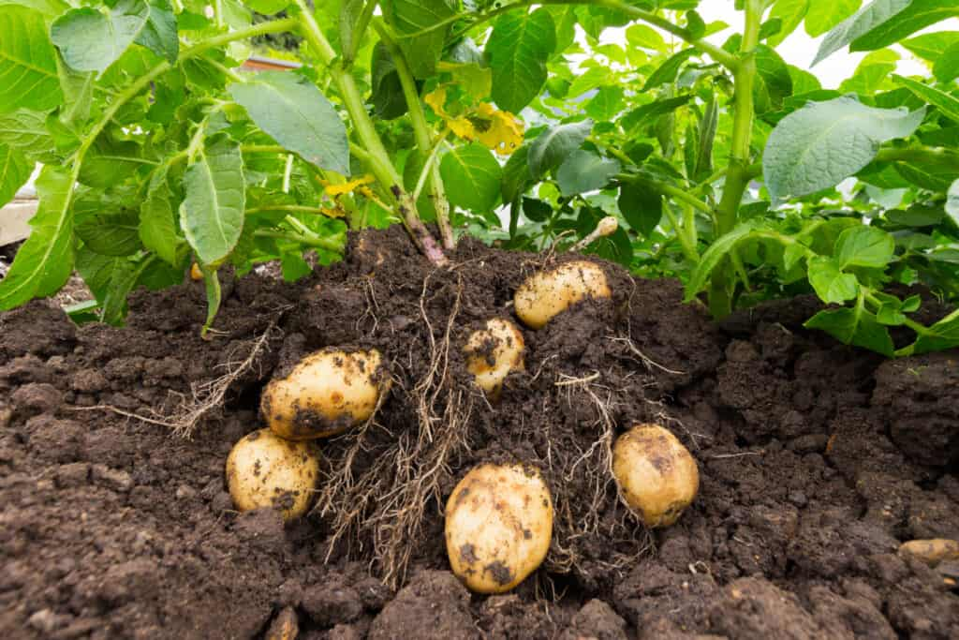
Overview
Pictorial representation of the idea:
Weeding carried out after 6 weeks from planting are basically ineffective and weeding should be carried out within 4 weeks.

Slide 5
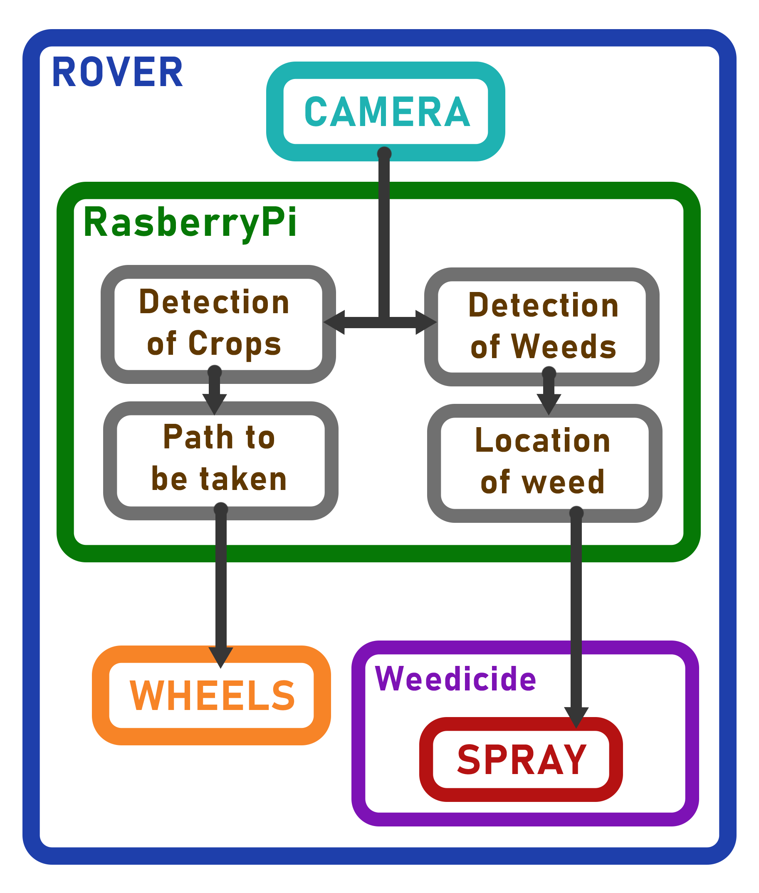
Block Diagram
Department of ECE
05

Slide 6
Requirement Analysis
Hardware | RasberryPi 4
 | PiCamera
 | DC Motors
 | Motor Drivers
 | Wheels
 | Li-ion battery
 | Solenoid Valve
 | DC Water Pump
 | Li-ion Battery Charger
Software | Open CV
 | Microsoft Lobe
Dataset
Department of ECE
06

Slide 7
Working and Implementation
Dataset Generation
Weed Detection
Weed Treatment
Crop Row Detection
Path Navigation
Rover Design
Rover Build
Department of ECE
07

Slide 8
Dataset Generation
Synthetic Dataset
Real Background Images
Compiler
Synthetic Images
Real Object Images
Generator
Random Input

Slide 9
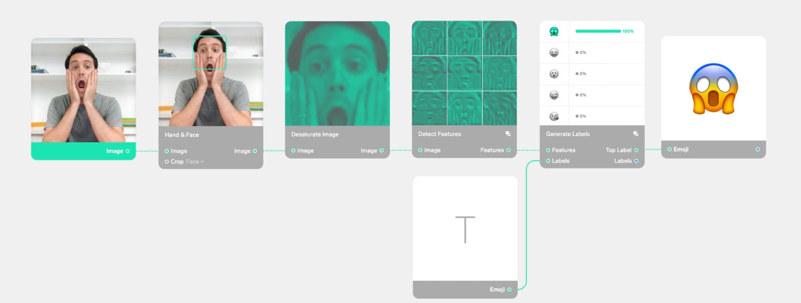
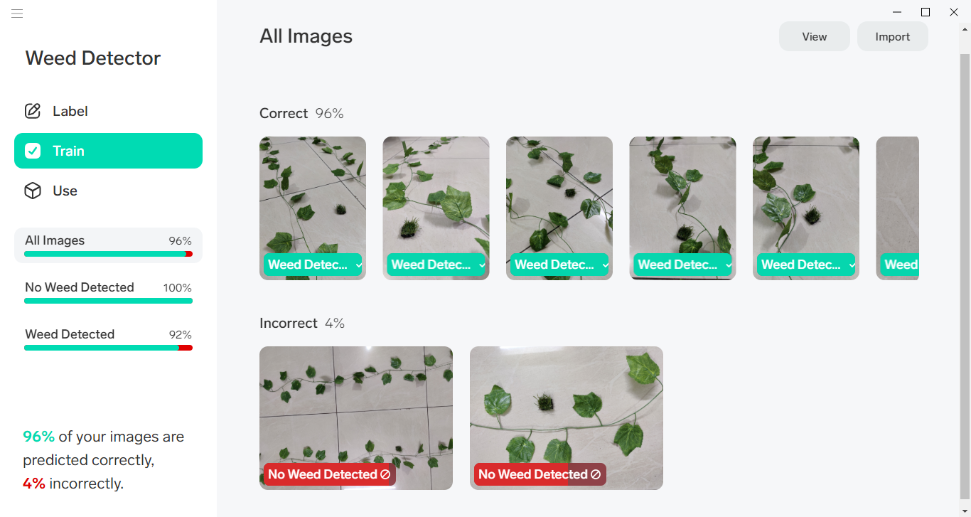
Weed Detection
Microsoft Lobe
Image classification
Object Detection

Slide 10
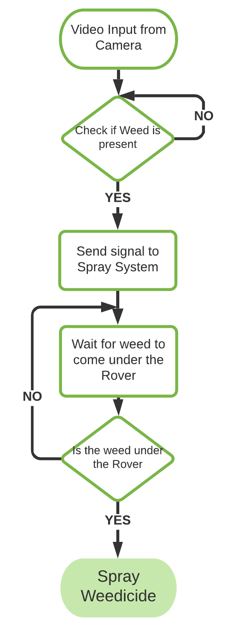
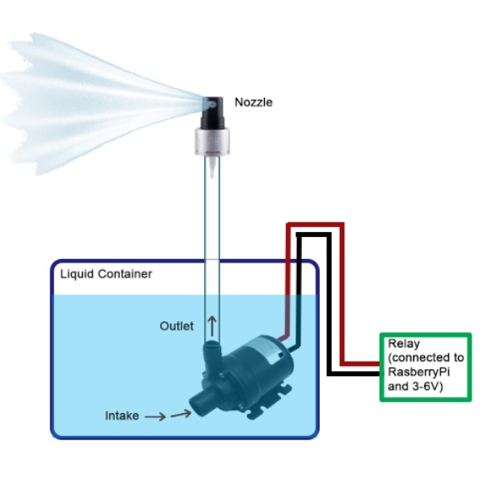
Weed Treatment
Weedicide Spray System
Full-cone Nozzle

Slide 11
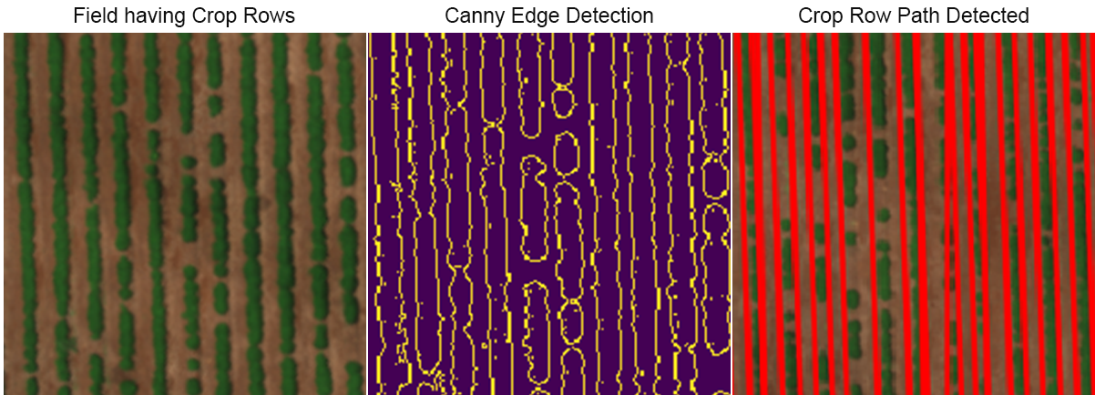
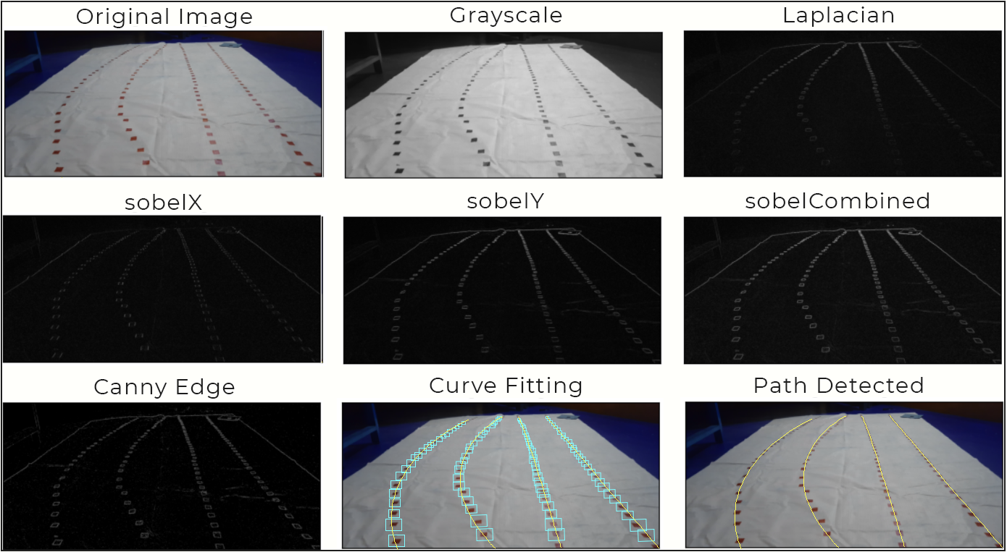
Crop Row Detection
Canny Edge
Detection
Test ground

Slide 12
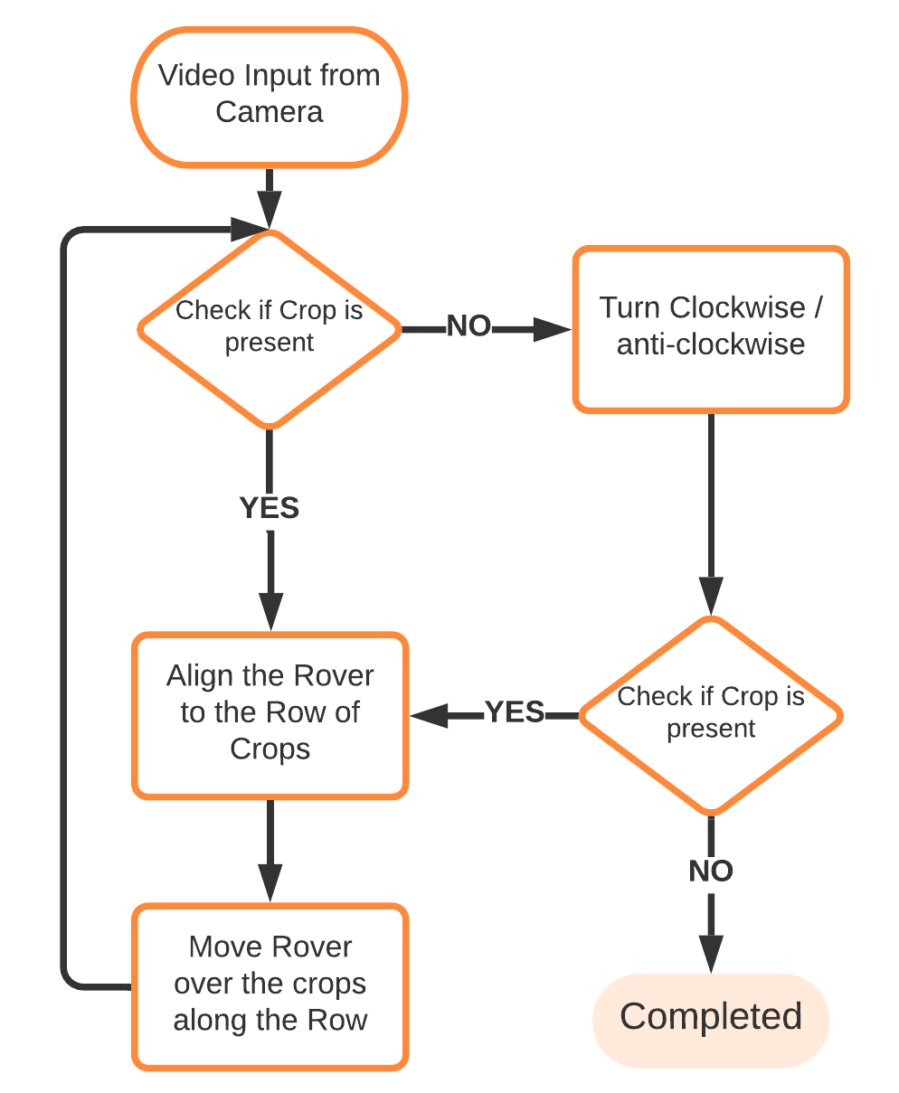
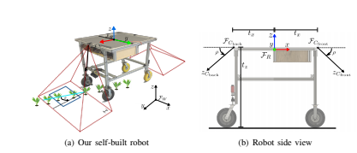
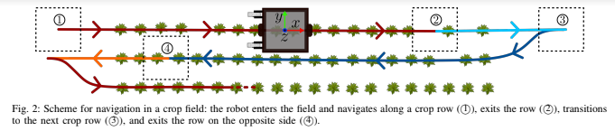
Path Navigation
Row-wise
Travel over the crops

Slide 13
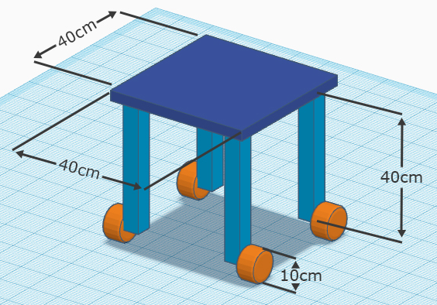
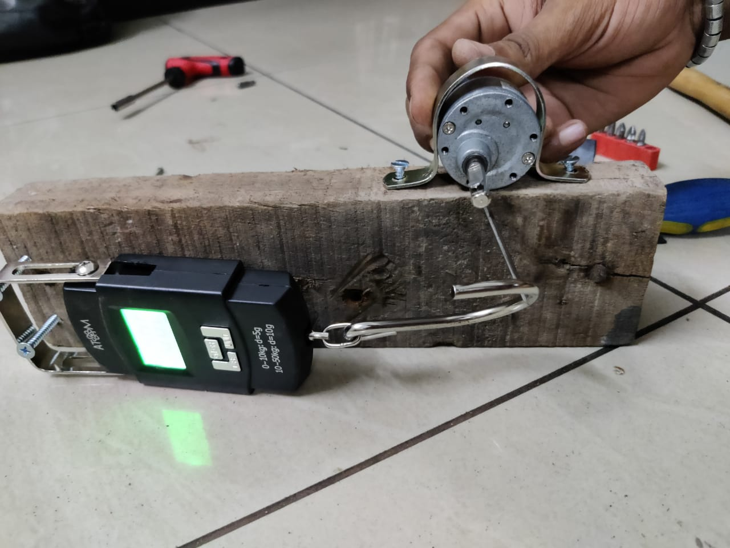
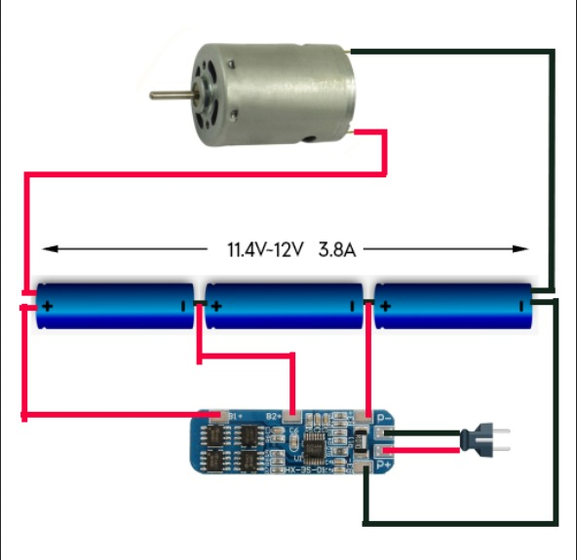
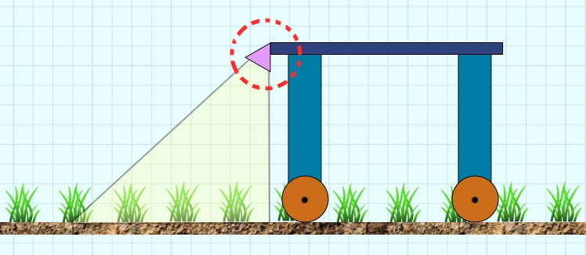
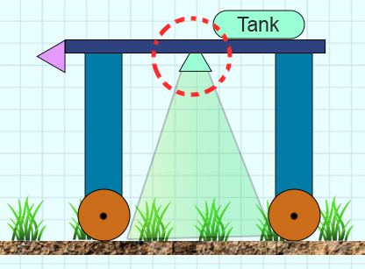
Rover Design
Rover Dimension: 40x40x40 cm
Motor Torque Testing
Battery Connections
Camera Angle
Spray Nozzle

Slide 14
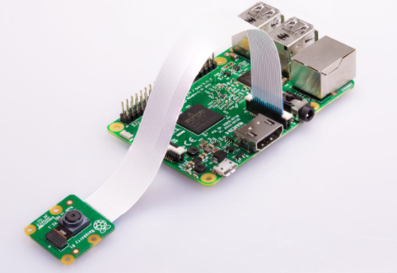
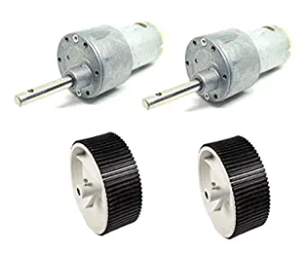
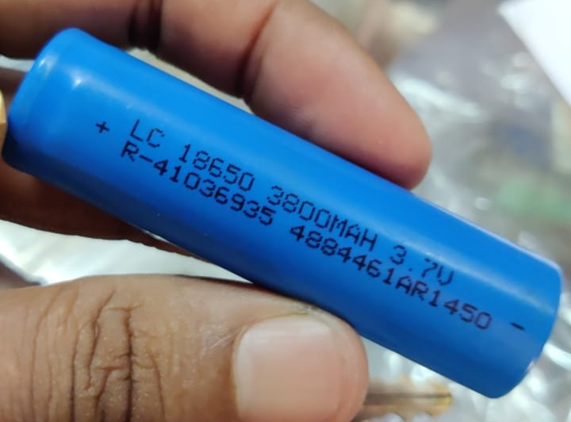
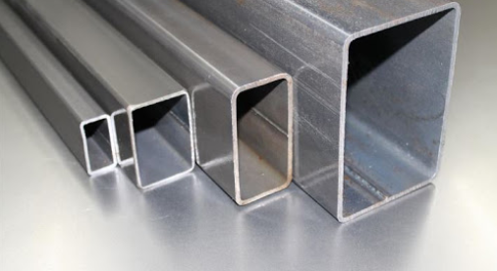
Rover Build
10 Kg-cm Torque Motor
18650 Li-ion batteries
RasberryPi4 and PiCamera
Aluminum Frame

Slide 15
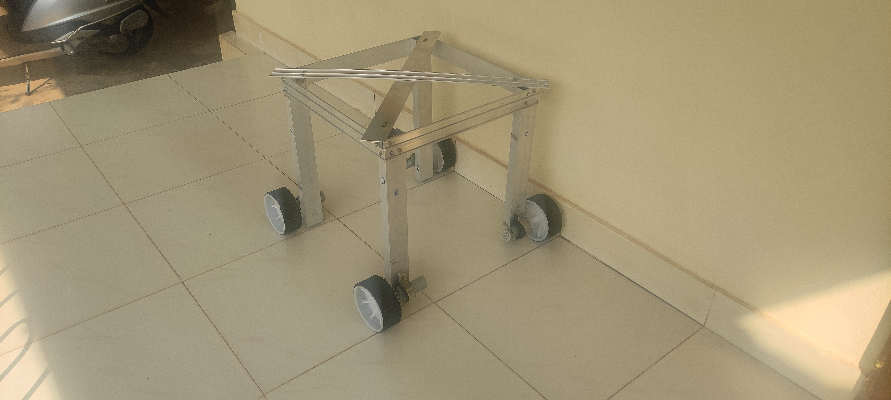
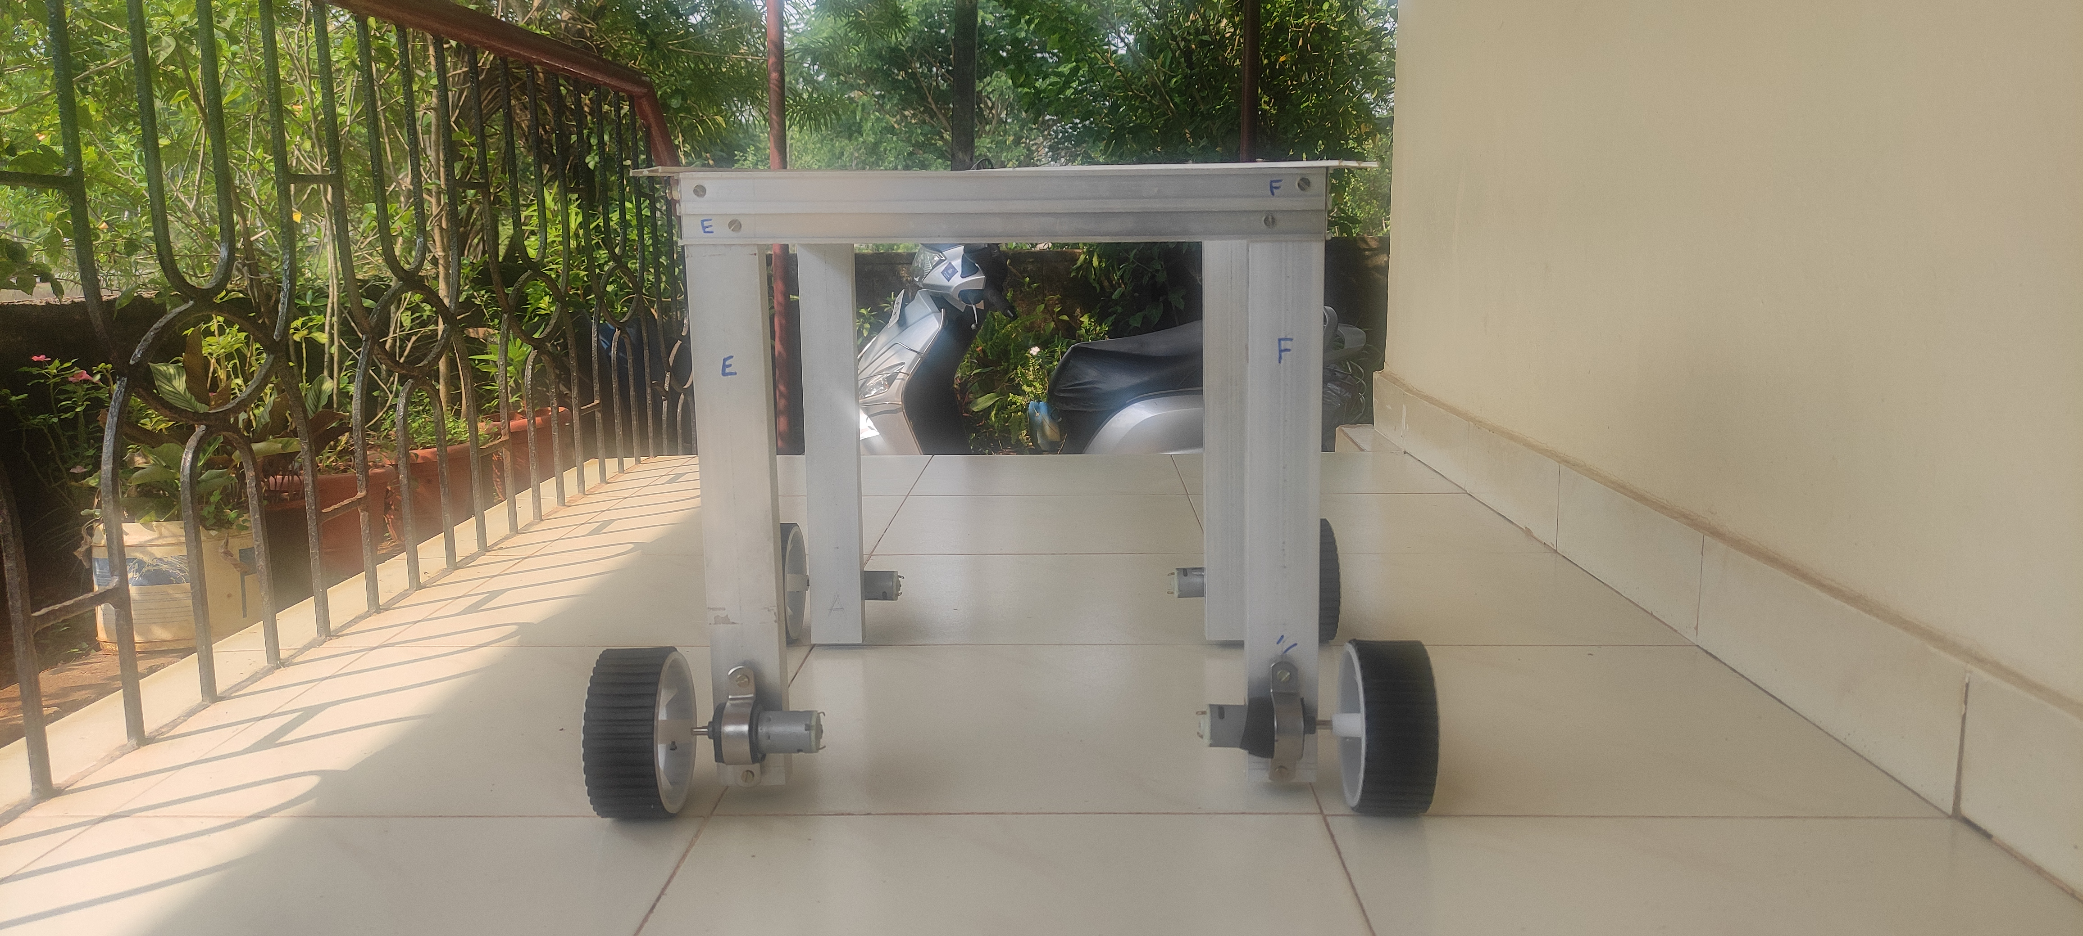
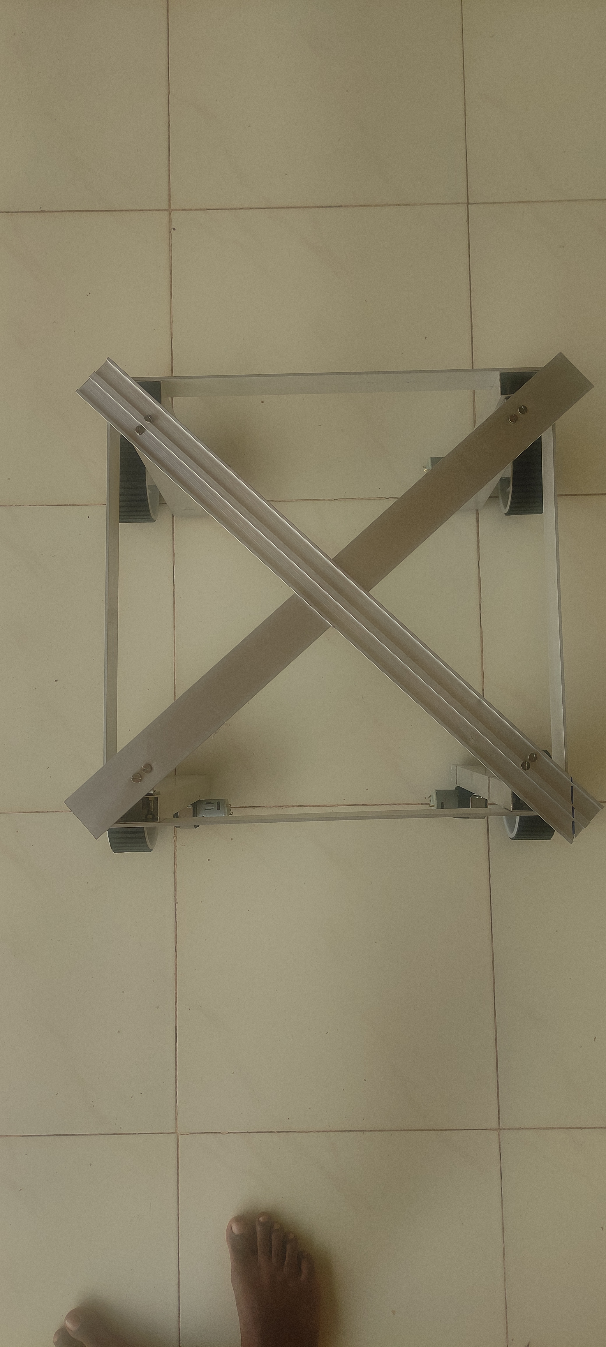
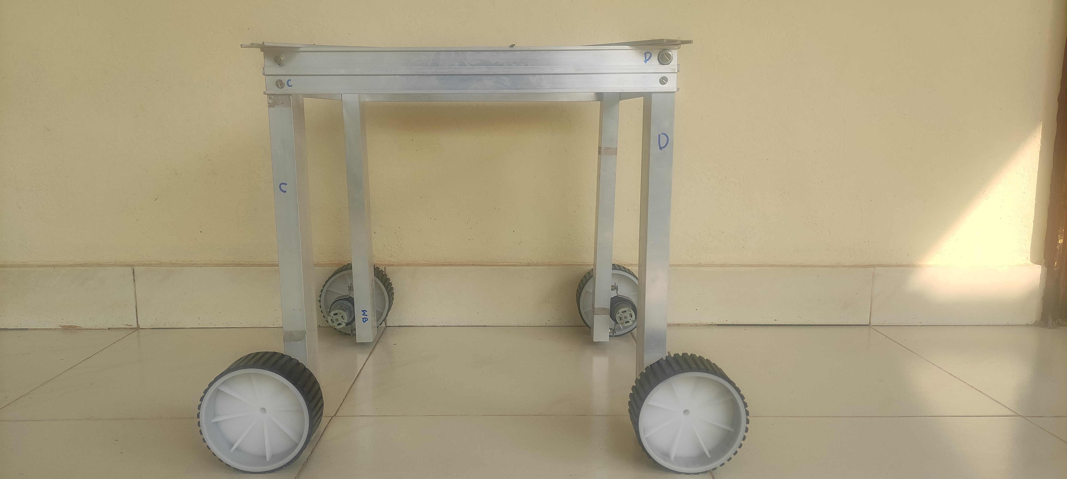
Rover Build
Front View:
Top View:
Side View:

Slide 16
Conclusion
The functioning of individual systems in the rover is working perfectly.
The mini rover has successfully navigated the test ground using Canny Edge Detection method.
The machine learning model trained using Microsoft Lobe, was able to correctly predict the presence of weed with an accuracy of more than 95%.

Slide 17
References
Andres Milioto, Philipp Lottes and Cyrill Stachniss, Real-time Semantic Segmentation of Crop and Weed for Precision Agriculture Robots Leveraging Background Knowledge in CNNs, IEEE International Conference on Robotics and Automation, 2018, 2229-2235.
S. Haug, A. Michaels, P. Biber, and J. Ostermann. Plant classification system for crop / weed discrimination without segmentation. InProc. of the IEEE Winter Conf. on Applications of Computer Vision(WACV), pages 1142–1149, 2014.
C.S. McCool, T. Perez, and B. Upcroft. Mixtures of Lightweight Deep Convolutional Neural Networks: Applied to Agricultural Robotics. IEEE Robotics and Automation Letters (RA-L), 2017.
Department of ECE
017

Slide 18
References
M. Di Cicco, C. Potena, G. Grisetti, and A. Pretto. Automatic model based dataset generation for fast and accurate crop and weeds detection. arXiv preprint, 2016.
Alireza Ahmadi, Lorenzo Nardi, Nived Chebrolu and Cyrill Stachniss, Visual Servoing-based Navigation for Monitoring Row-Crop Fields, 2020 IEEE International Conference on Robotics and Automation (ICRA), 4920-4926.
6. C.S. McCool, J. Beattie, J. Firn, C. Lehnert, J. Kulk, R. Russell,T. Perez, and O. Bawden. Efficacy of mechanical weeding tools: Astudy into alternative weed management strategies enabled by robotics (2). IEEE Robotics and Automation Letters (RA-L), 2018.
Department of ECE
018

Slide 19
References
D. de Lima and A. Victorino. A visual servoing approach for roadlane following with obstacle avoidance. In Proc. of the International Conference on Intelligent Transportation, pages 412–417, 2014.
H. S. Midtiby, T. M. Giselsson, and R. N. Jrgensen. Estimating theplant stem emerging points (pseps) of sugar beets at early growthstages. Biosystems Engineering, 111(1):83 – 90, 2012.

Slide 20
Thank You
Department of ECE
020

